Slide 1

Decoding Visual Information use MVPA Datasets:Haxby_dataset
ALee
4/8/2017

Slide 2
Content
Expermient Design
A
Image Analysis
B
Conclusion
C

Slide 3


Slide 4
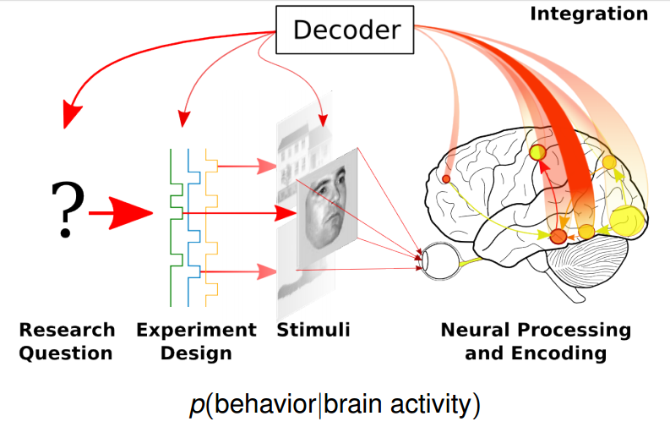
Michael Hanke & Yaroslav Halchenko

Slide 5
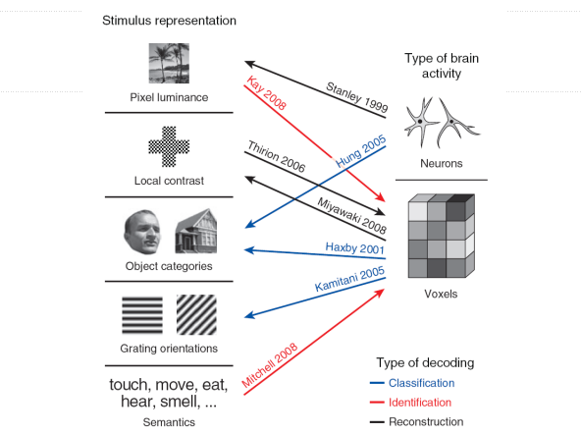
Advanced Research
Kay and Gallent, 2009

Slide 6
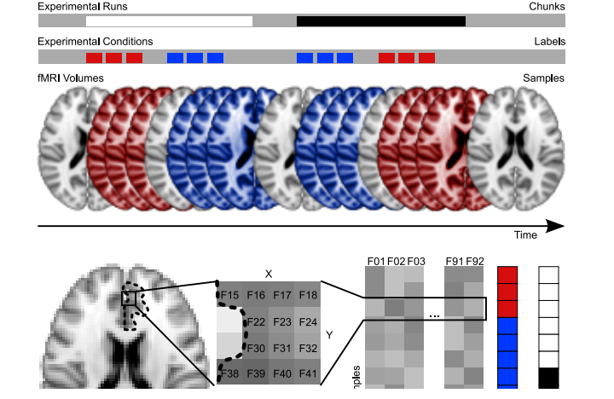
1.Experiment Design
James V.Haxby etc al, 2001

Slide 7
Datasets Information
Subjects: 6
TR = 2.5 s
TE = 30 ms
GE 3T scanner (General Electric, Milwaukee, WI)
Flip angle = 90
Field of view (FOV) = 24 cm
Stimuli weRe gray-scale images :faces, houses, cats, bottles, scissors, shoes, chairs, and nonsense patterns
This data was obtained from the OpenfMRI database. Its accession number is ds000105

Slide 8


Slide 9
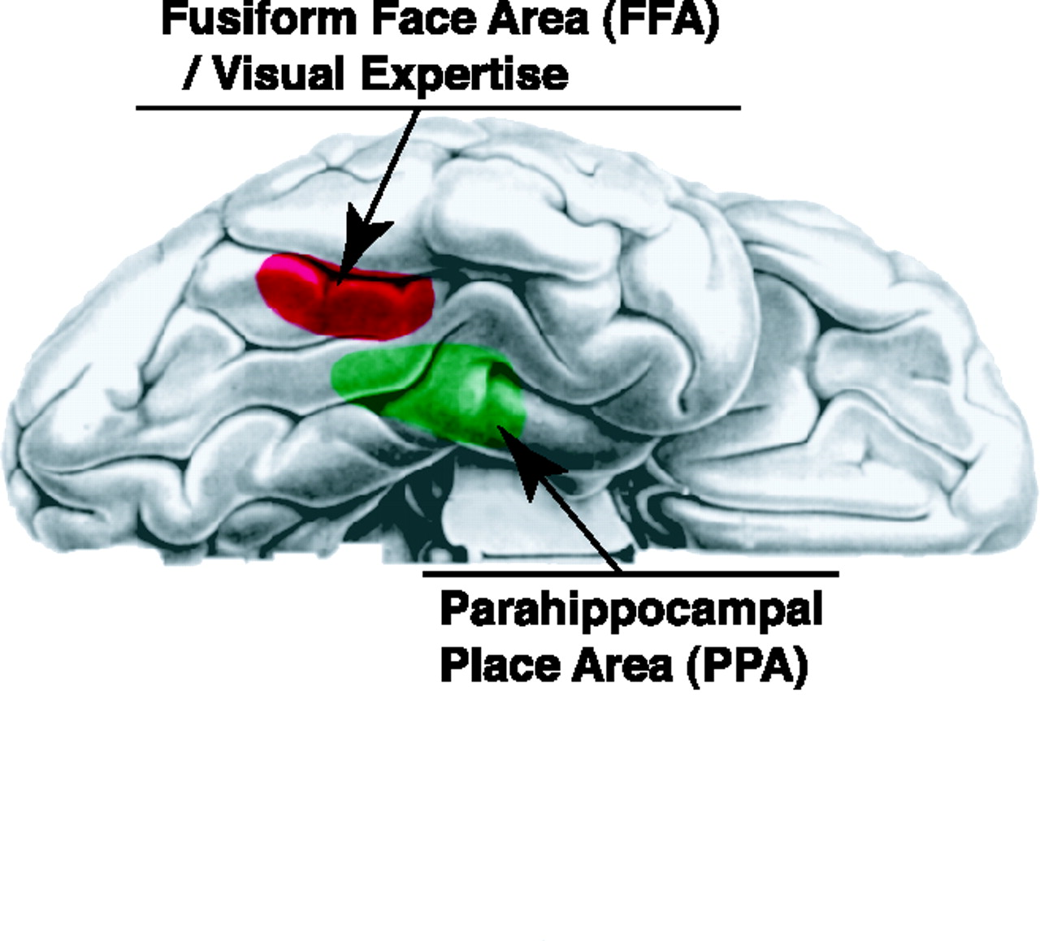
James V. Haxby etc al, 2001

Slide 10
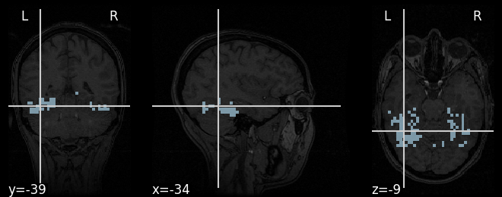
vt mask_img
‹VOI›

Slide 11
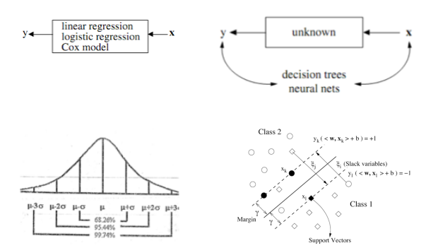
Support Vector Machine
Breiman etc al, 2001

Slide 12
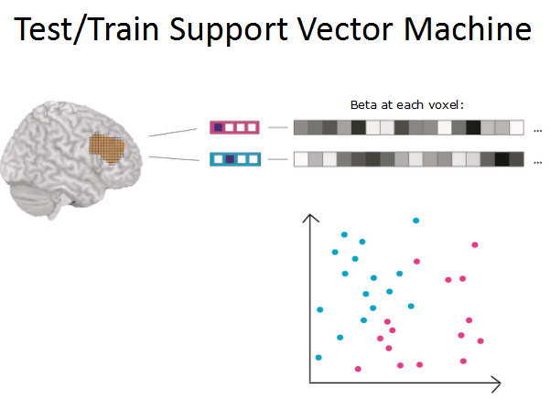
Alexandra Woolgar, John Duncan

Slide 13
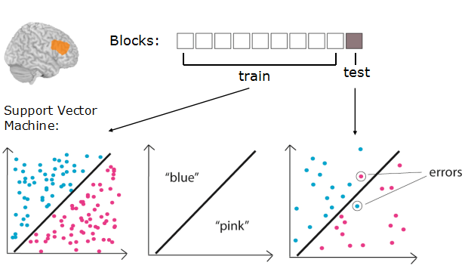
Leave One label Out

Slide 14
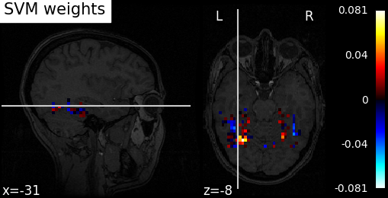

The First Method
faces and houses
faces and cats
Accuracy(mean): ?
Accuracy (mean): 68.9815%

Slide 15
Searchlight

Slide 16
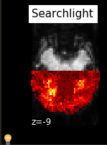
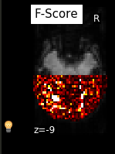
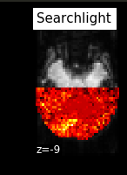
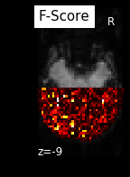
Searchlight
faces and cats
faces and houses

Slide 17
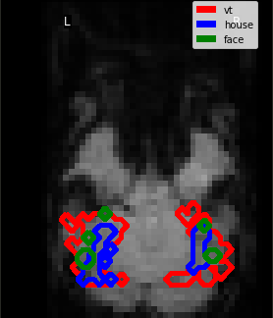

Slide 18
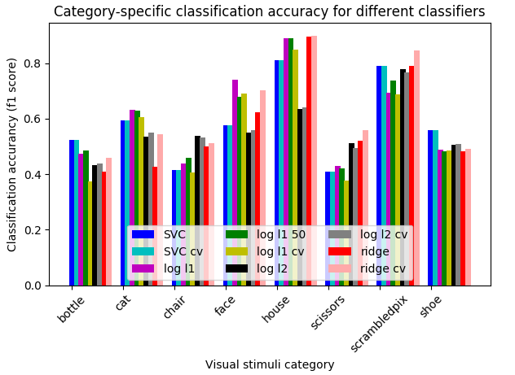

Slide 19


